Slide 1
What is a Zoning By-law
City of Yellowknife
September 2021

Slide 2
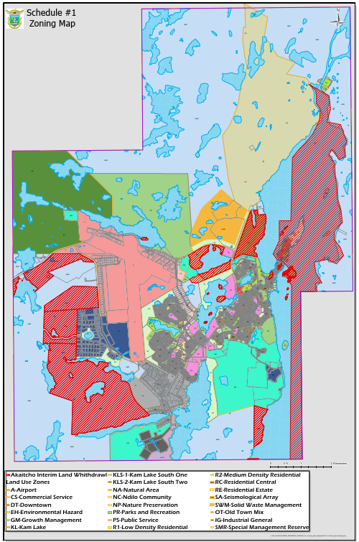
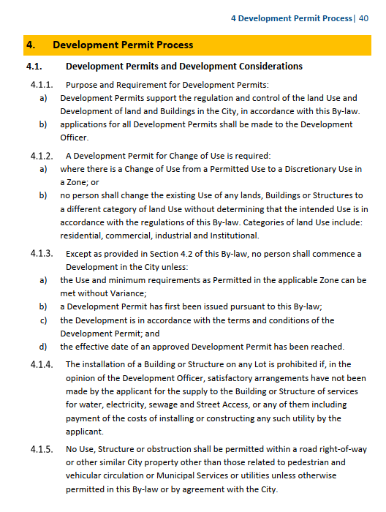
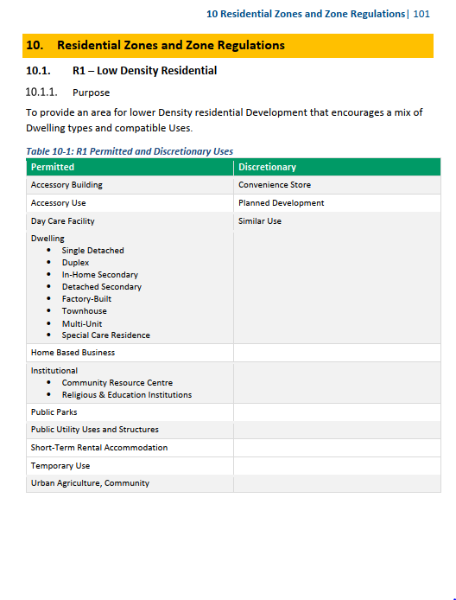
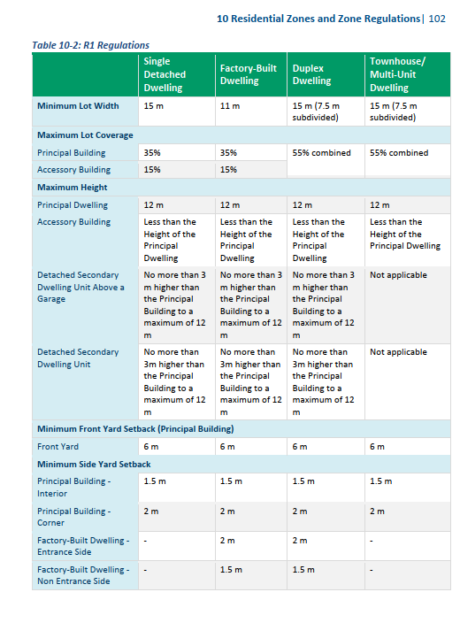
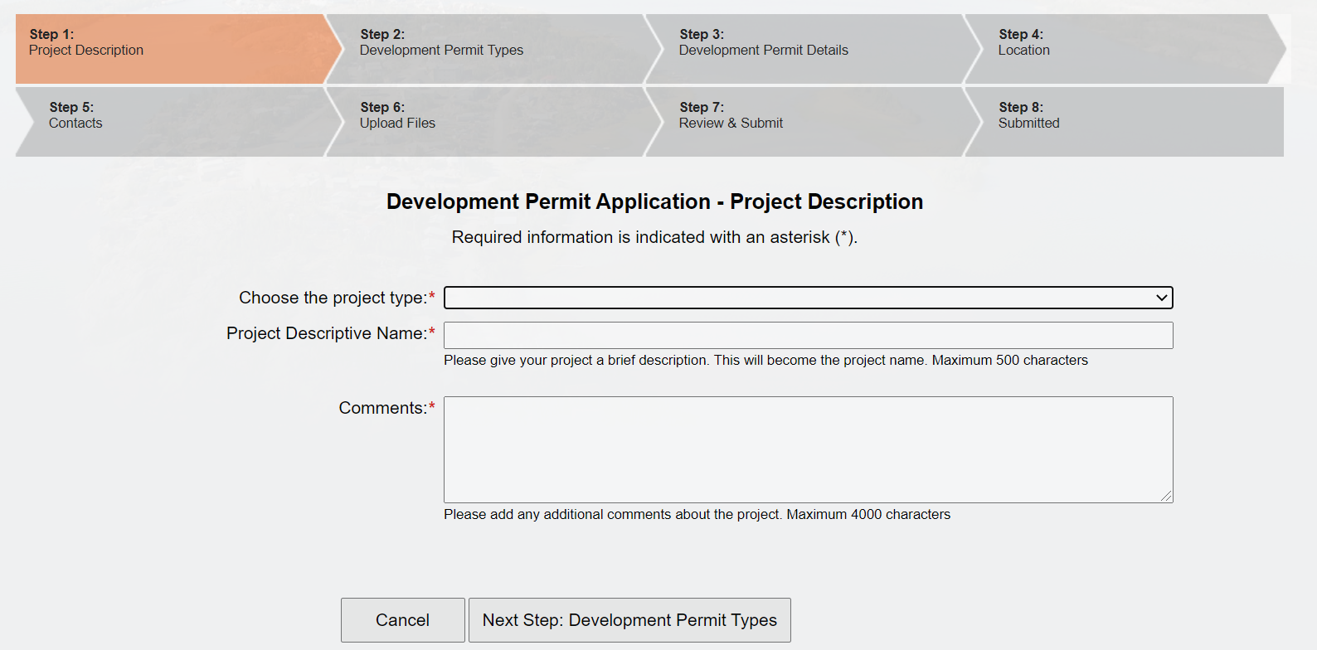
Zoning By-law
1. Zoning Map
2. Permitted Uses and Regulations
3. Development Permit
A set of rules for development that implements the City of Yellowknife’s vision, principles and priorities for the community.

Slide 3
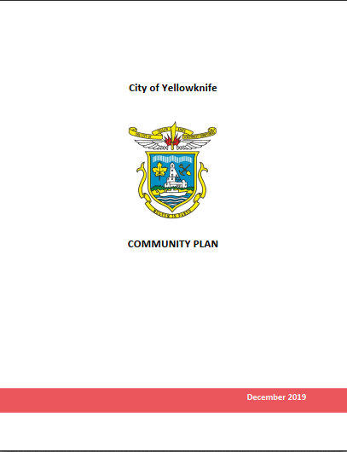
Implements the 2020 Community Plan
  Implements the broad policy direction
  Creates regulations that can be enforced.
  Practical application of the Community’s vision

Slide 4
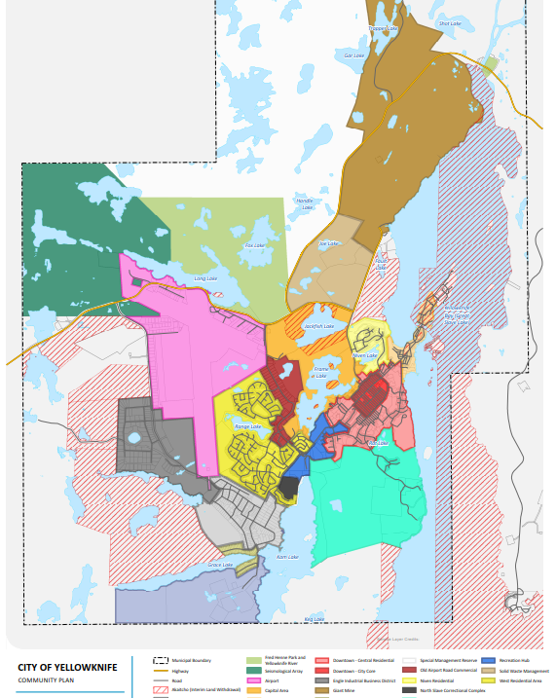

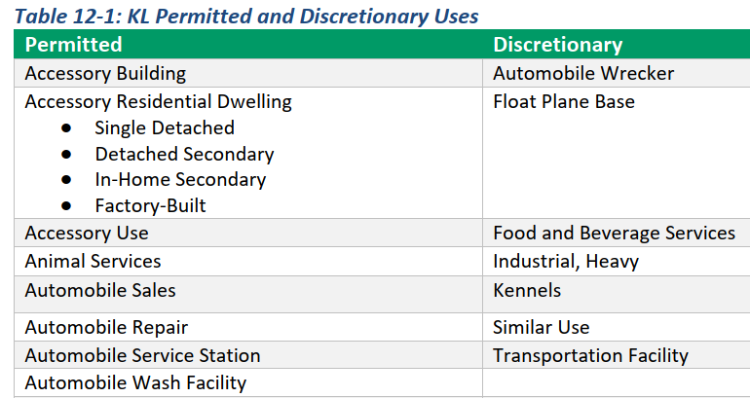

Implements the 2020 Community Plan – Example Kam Lake
CP Designation Map
Zoning Map
Animal Services: means a building or structure for the purpose of medical treatment or grooming that involves the short-term and temporary shelter of animals. May be supported by the retail sales of associated products. This may include veterinary clinics and hospitals, pet grooming salons, and dog daycares.

Slide 5
Considerations for Zoning By-Law
  Consistent with the Cities Town and Villages Act;
  Compliant with the Community Planning and Development Act;
  Land Use Planning Best Practices;
  Lived experiences within the City and lessons learned; and
  Feedback from residents, business, community organizations and Indigenous governments

Slide 6
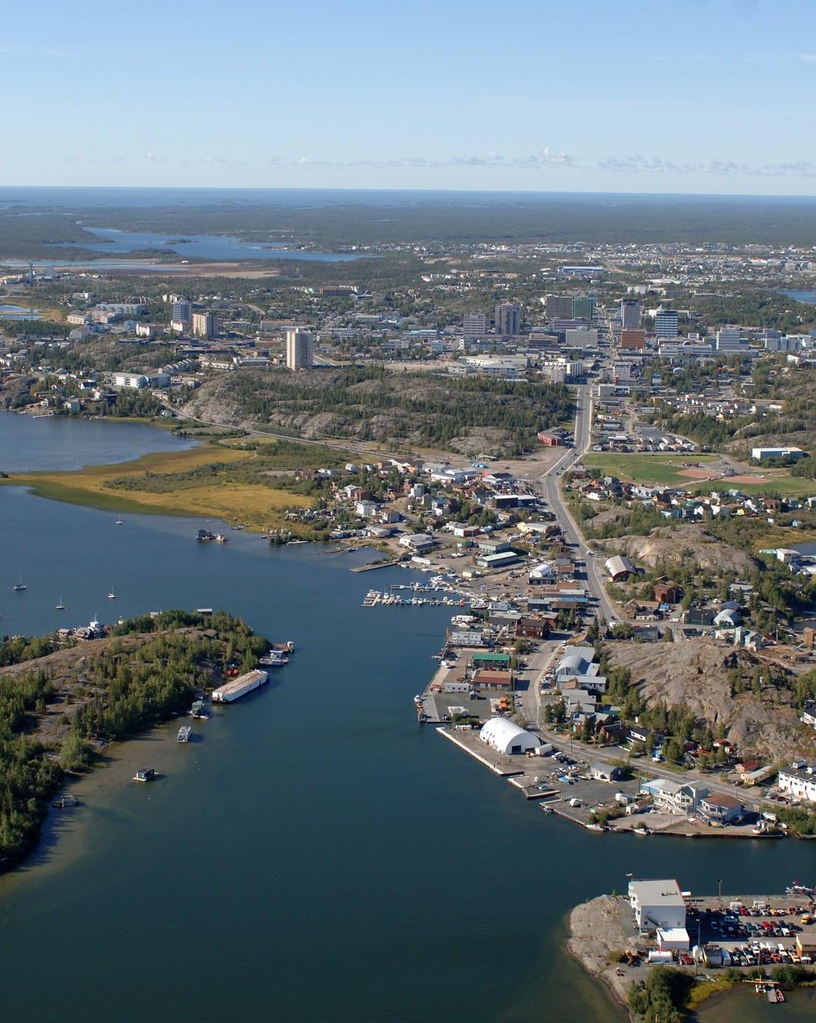
Why is it important?
  Separates incompatible uses
  Tool that supports development approaches and innovation
  Establishes consistency and fairness
  Enhances existing neighbourhoods

Slide 7

DRAFT ZONING BY-LAW
DOWNTOWN ZONE

Slide 8
Direction from Community Plan
Downtown Zone is the City Core under the Downtown land use designation
Intended to remain the central area of the community and serve as the highest order mixed use centre.
Policies & Objectives include allowing for greater residential density, increase flexibility of land uses supporting the City’s downtown revitalization strategy, allow for mixed uses, removing off-street parking minimums

Slide 9
Permitted & Discretionary Uses
New Permitted Uses include: Artisan Studio, Brewing/Distilling Establishment & Brewpub, Special Care Facility, Personal Services.
New Discretionary Uses include: Single Detached Dwelling and Duplex (no more Single Detached Dwelling & Duplex Overlay)
Regulations categorized by Residential Uses and Mixed/Non-Residential Uses.

Slide 10

Open Option Parking (Downtown)
The market will decide how many parking spaces to allot per use
No impact to on-street parking
Supports densification and downtown revitalization

Slide 11
DRAFT ZONING BY-LAW
RESIDENTIAL CENTRAL ZONE

Slide 12
Direction from Community Plan
Residential Central Zone is located in the Downtown - Central Residential land use designation
Identified as a transition area between the high-density city core and other area designations.
Planning Policies & Objectives include: intensifying land use through higher density development, encourage higher density residential development, encourage a variety of housing options, and increase mixed land uses

Slide 13
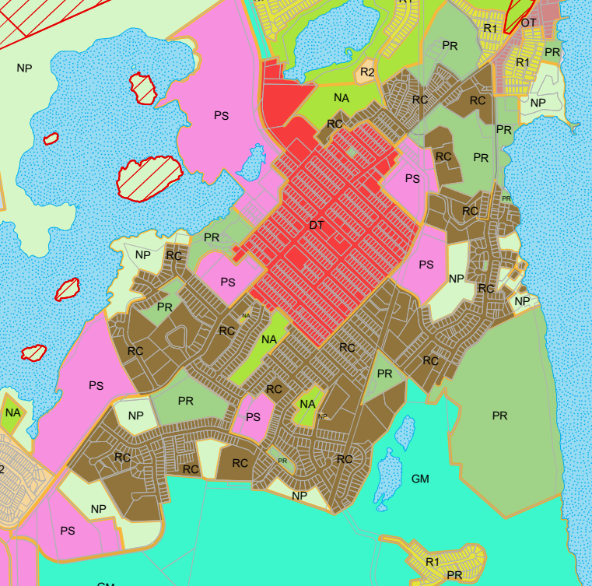
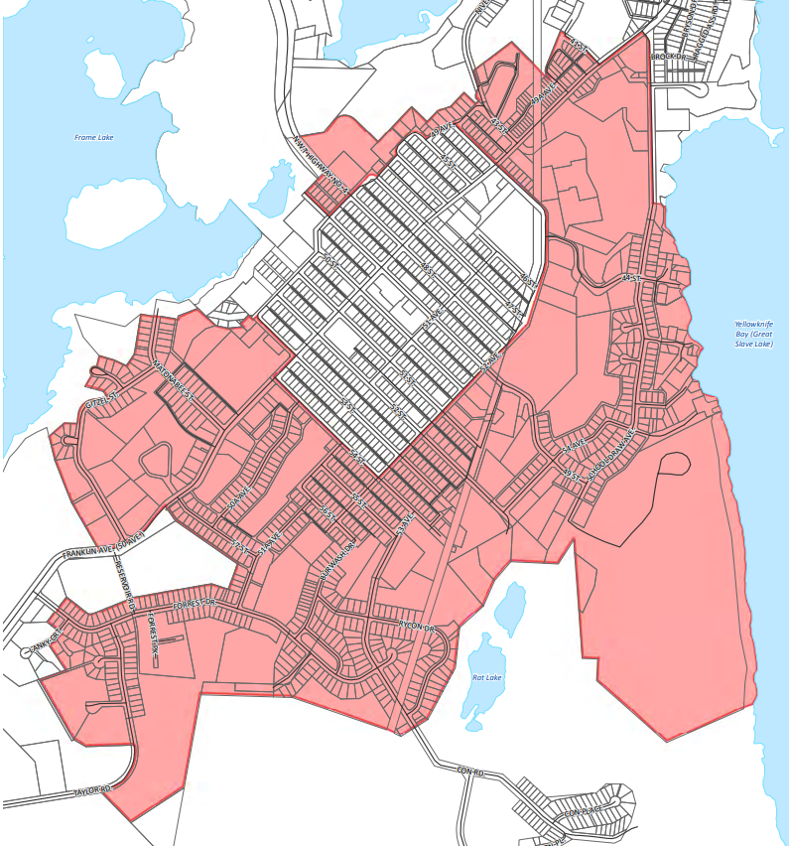
Community Plan Designation vs. Zoning

Slide 14
RC: Residential Central
Updates the use of land around the City Core and allows for a greater variety of residential uses & complimentary uses
Preserves and enhances the character of the neighbourhood by encouraging new buildings to fit the character of the existing neighbourhood
Any medium to higher density development will need to have land assembled in order to proceed.

Slide 15
Simple and Clear Development Rules
Redundant information has been removed
Took into consideration Land Use Planning Best Practices
Development regulations specific to residential and non-residential uses have their own sections in the By-law

Slide 16
DRAFT ZONING BY-LAW
INFILL & DENSIFICATION

Slide 17
Direction from Community Plan
As outlined in the 2020 Community Plan:
  10, 514 ha of land exists within the municipal boundary
  4, 925 ha of this land is available for potential development
  97.3% of that untenured and under the control of the GNWT
  Only 118 ha is private or City-tenured land
  Much of this remainder has restrictions or is being used as public recreational lands

Slide 18
Densification and Infill
Support downtown revitalization
Support development of complete communities
Addresses the ‘missing middle’
Encourages active transportation and transit supportive development
Climate Change mitigation
40% of Yellowknife’s downtown core is being used for surface parking (not including street parking). Open Option Parking will allow parking to be dictated by demand.
Infill development of new uses could occur where there are parking lots.

Slide 19
DRAFT ZONING BY-LAW
AGRICULTURE

Slide 20
Direction from Community Plan & GROW
Agriculture and Food production should not only be permitted, but encouraged.
Used Yellowknife’s GROW strategy to guide the by-law e.g. deregulating the creation of small scale farms on residential lots.
Areas where Agriculture is Permitted: Central Residential Designation, Kam Lake, & Kam Lake South

Slide 21
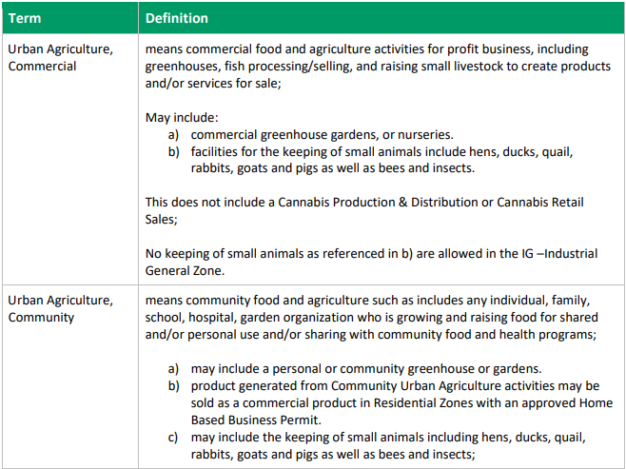
Making it easier for Yellowknifers to grow
Where are these uses allowed?
Urban Agriculture, Commercial- RC, CS, OT, KL, KLS 1 & KLS 2, IG, PS, PR, NP, GM.
Urban Agriculture, Community- All Residential Zones, CS, OT, KL, KLS 1 & KLS 2, IG, PS, PR, NP, GM.

Slide 22
Getting to know Urban Agriculture in the new Zoning By-law
No Development Permit is required for: gardens where the purpose is to grow fruits, vegetables and herbs in a private Yard or community garden for personal or community consumption (Section 4.2.1 (q)).
Section 7.13.2 dedicated to Urban Agriculture requirements, including clarity for animal enclosures

Slide 23
DRAFT ZONING BY-LAW
INDUSTRIAL LAND USES
(KAM LAKE; ENGLE BUSINESS DISTRICT)

Slide 24
Direction from Community Plan
To accommodate larger scale commercial and light industrial operations such as warehouses, large commercial show rooms, outdoor storage, and agriculture activities that require more land than commercial activities typically found in the City Core or commercial areas; To support commercial horticulture and agriculture

Slide 25
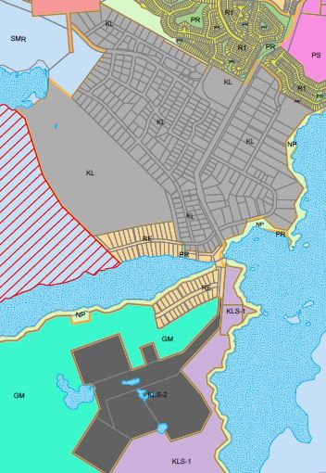
KL – Kam Lake
Additional land has been zoned for KL, KLS 1, and KLS 2
Zones have been updated to reflect how Yellowknife has changed in recent years
Identified as a “live and work” community

Slide 26
What’s New?
5 zones have been reduced to 1
Light and heavy industrial activities are more clearly defined
More clarity in permitted and conditional uses
What is New?
Light Industrial
Industrial
Growth Management
Kam Lake
Kam Lake Residential Overlay
Kam Lake

Slide 27
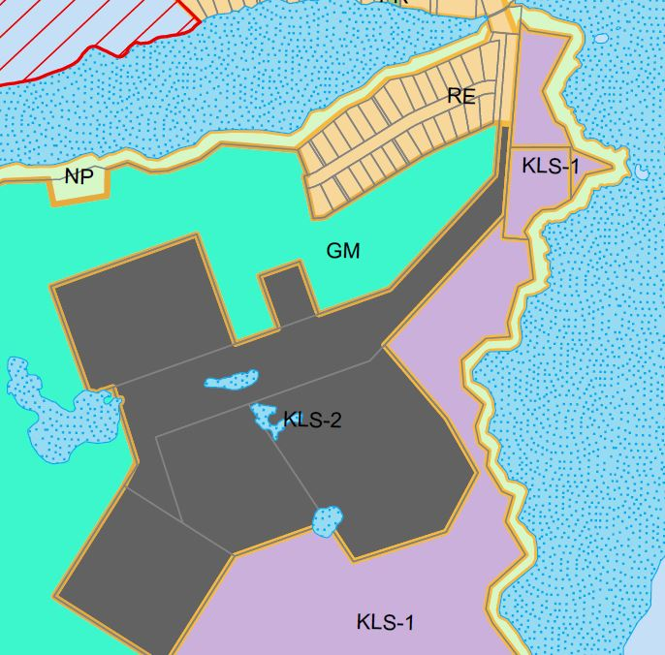
KLS 1 – Kam Lake South 1
Provides land for:
  Commercial recreation
  Dog lots (Yellowknife Kennels)
  Urban agriculture operations
  Light industrials uses with accessory residential use
Limits industrial development to minimize impact to surrounding neighbors

Slide 28
KLS 2 – Kam Lake South 2
Provides lands dedicated for light industrial and heavy commercial uses
Permits aggregate extraction, subject to provisions

Slide 29
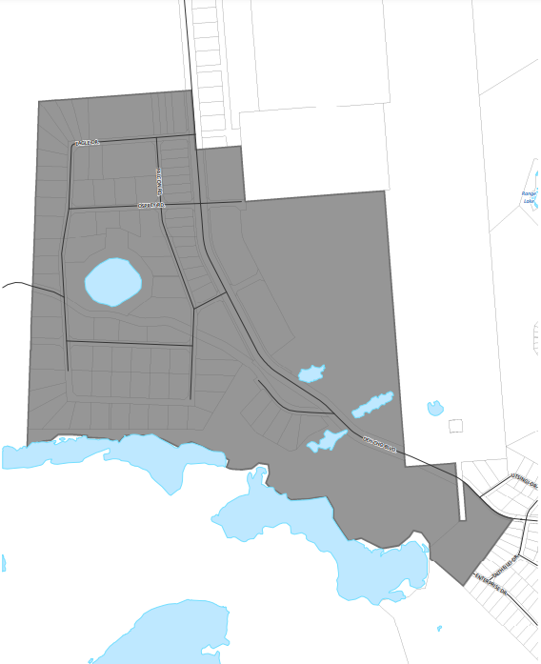
Engle Business Industrial District
Intended to accommodate a variety of general industrial and business industrial uses
Uses that are not compatible with human habitation.
No residential uses permitted

Slide 30
DRAFT ZONING BY-LAW
PARKING

Slide 31
Direction from Community Plan
To reduce single use surface parking lots and remove off-street parking minimums (Downtown)
To reduce off-street parking minimums (Central Residential)
Encourage compact urban form and no longer permit surface parking lots (Old Town)

Slide 32
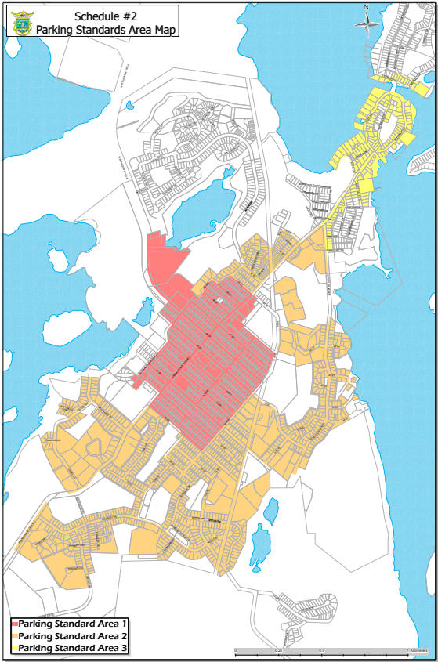
Introducing 4 ‘Parking Standard Areas’
Downtown (red)
Residential Central (orange)
Old Town (yellow)
Rest of Yellowknife (white/blank)

Slide 33
Open Option Parking (Downtown)
The market will decide how many parking spaces to allot per use
No impact to on-street parking
Supports densification and downtown revitalization

Slide 34
Central Residential & Old Town
Decreased minimum parking requirements
No impact to on-street parking
Supports densification and infill

Slide 35
All other Zones in Yellowknife
Little to no change from Zoning By-law 4404

Slide 36
Shared Parking & Car Share
Continue to be options to help Developers achieve minimum parking requirements

Slide 37
Next Steps
Milestones
Implementation
Oct 1 – Last day for public review
October 25 – GPC – Public Comments
Nov – GPC – Council Final Draft
– First Reading
– Statutory Public Meeting
Update application processes
Educational Materials
Create service standards
Monitor and track development
Report back to Council

